Slide 1

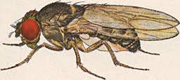
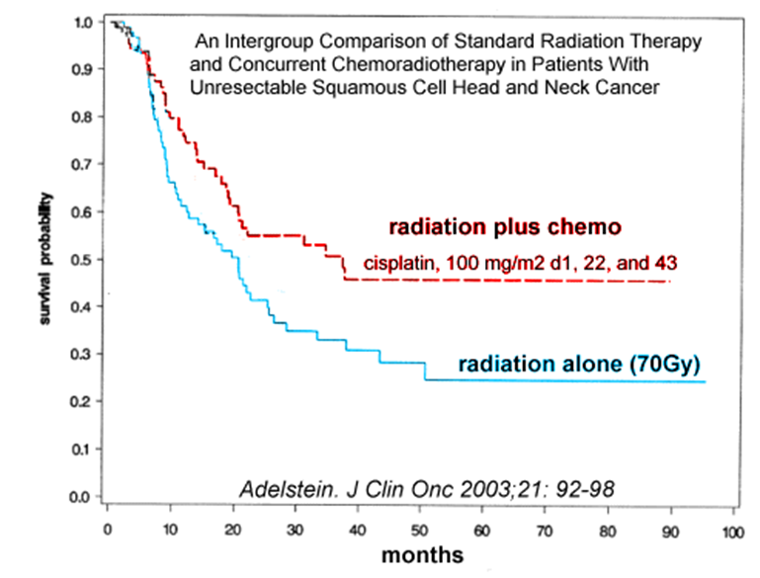
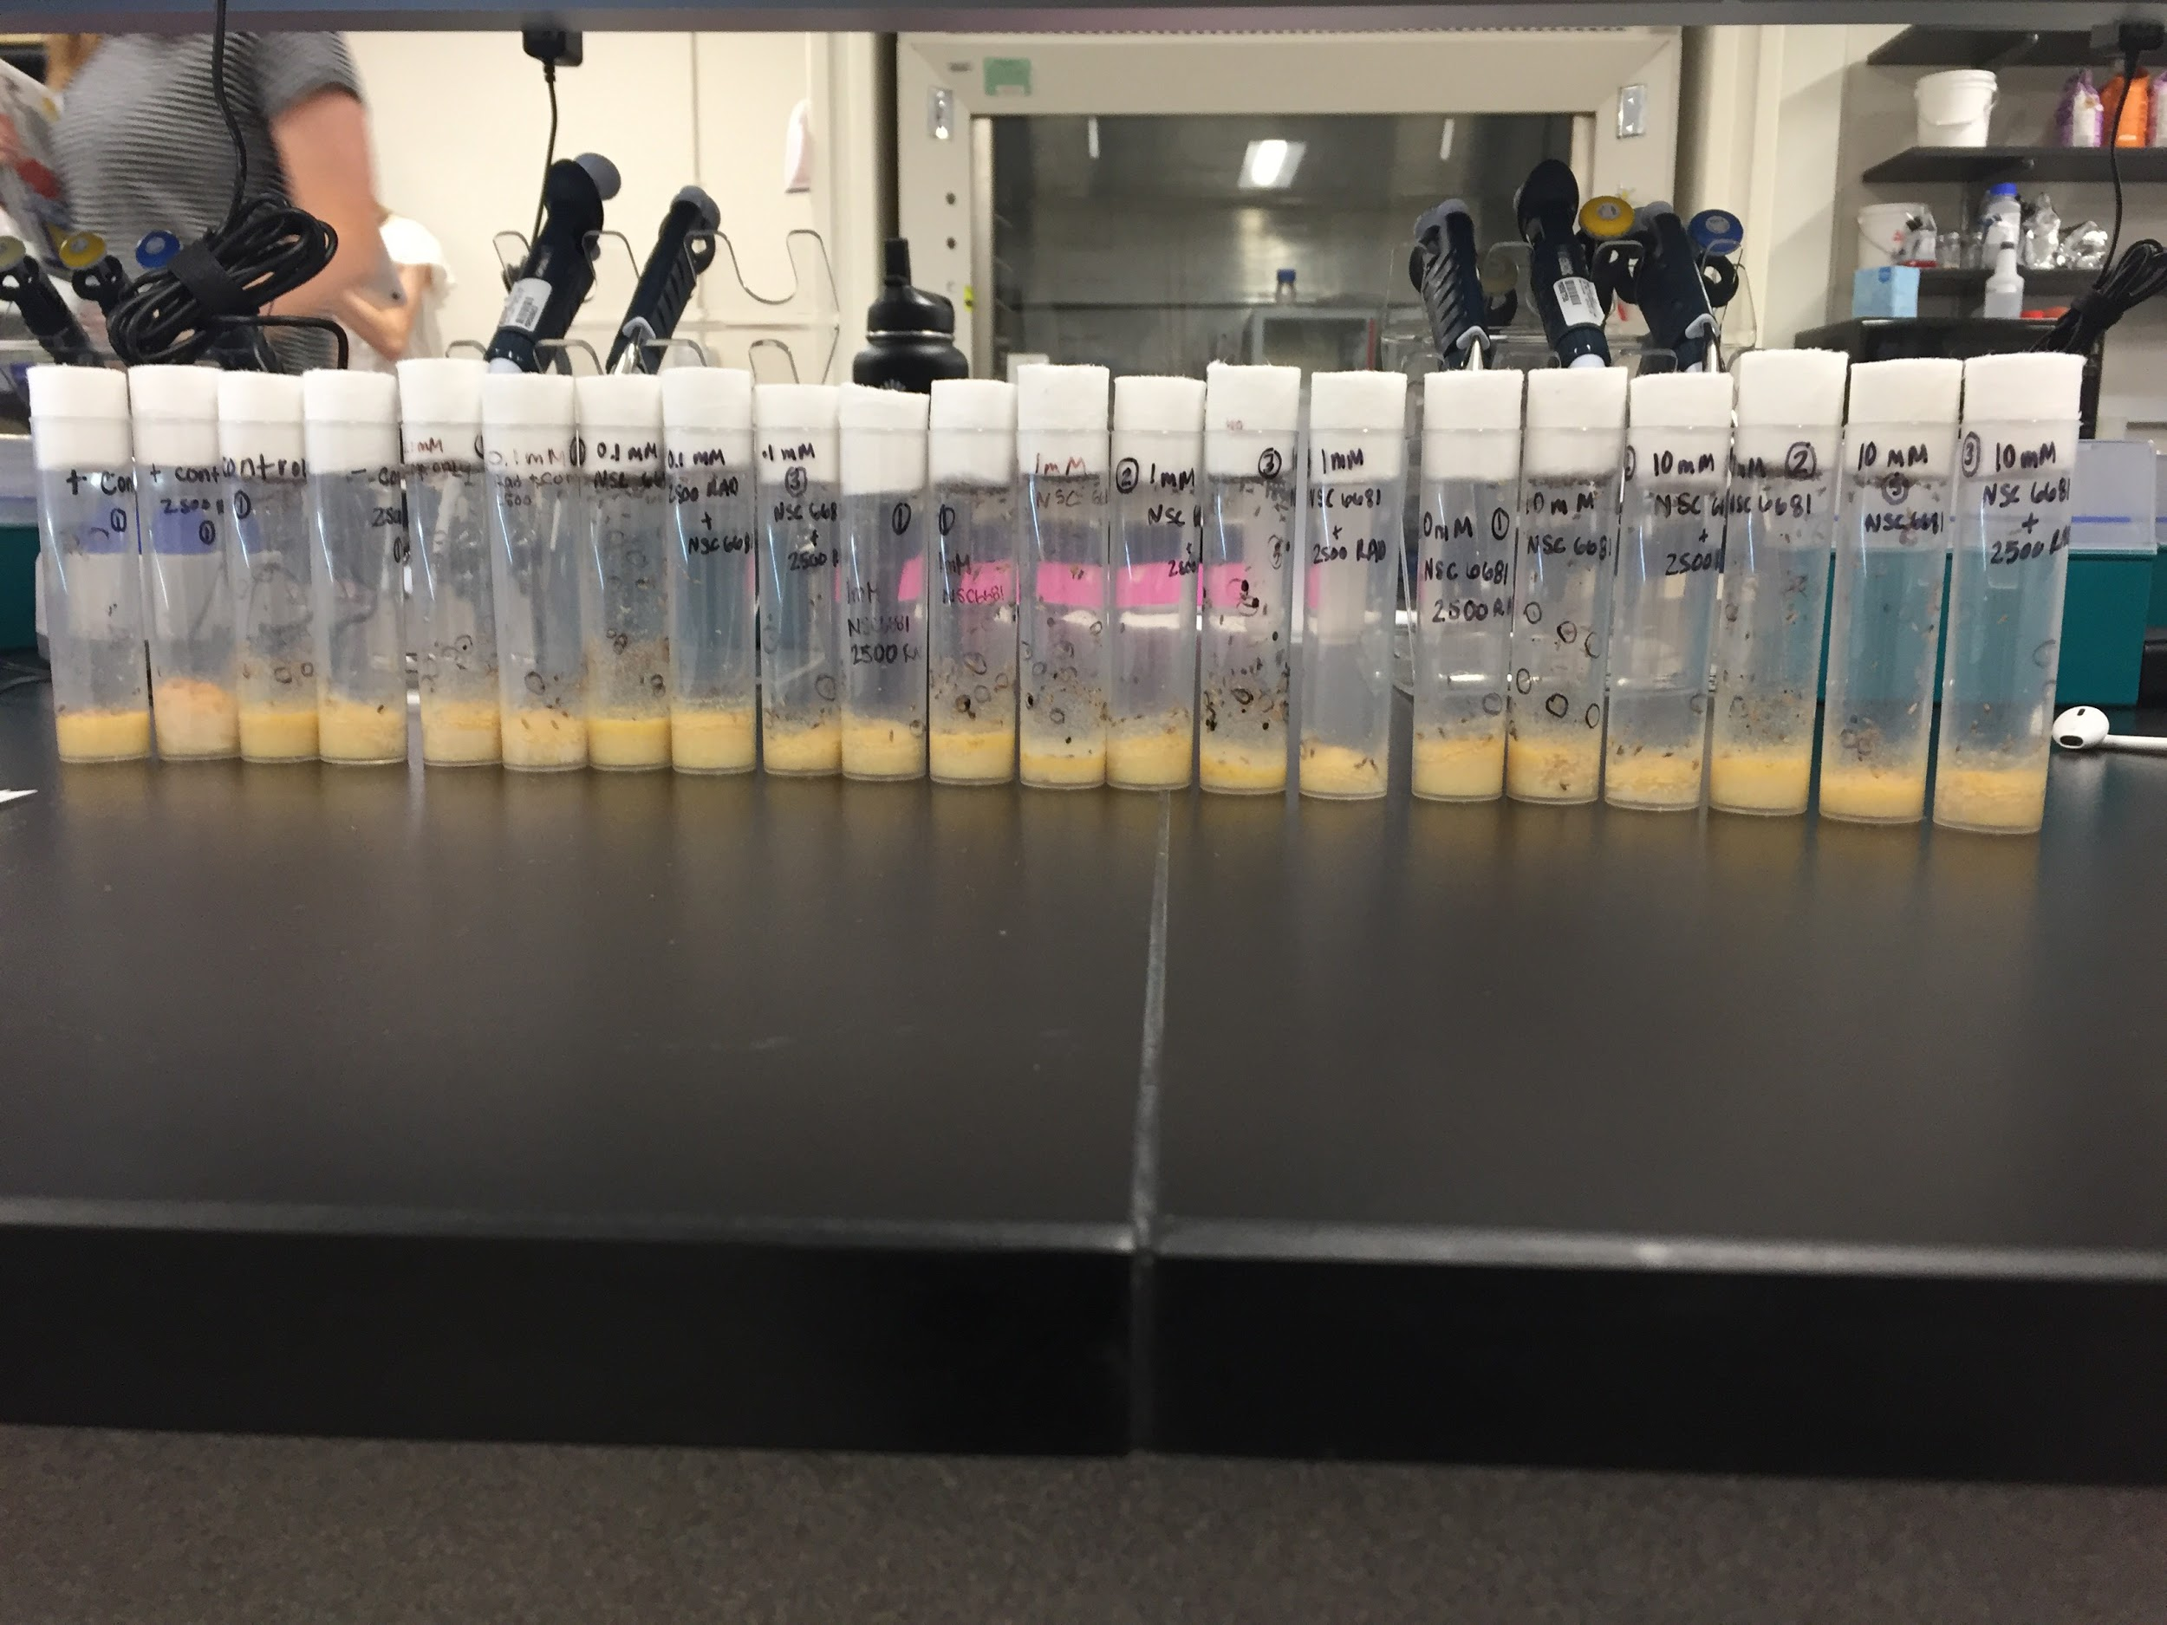
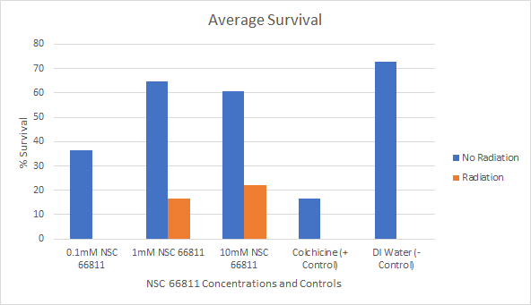
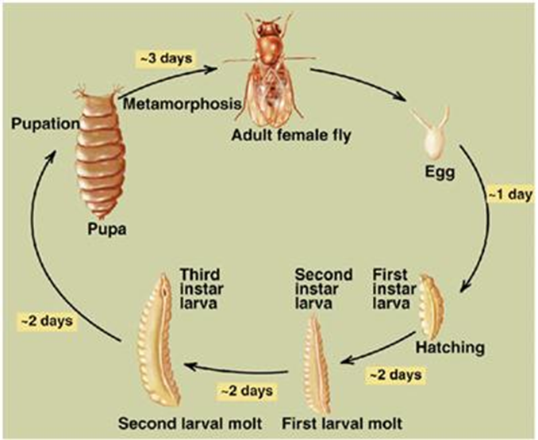
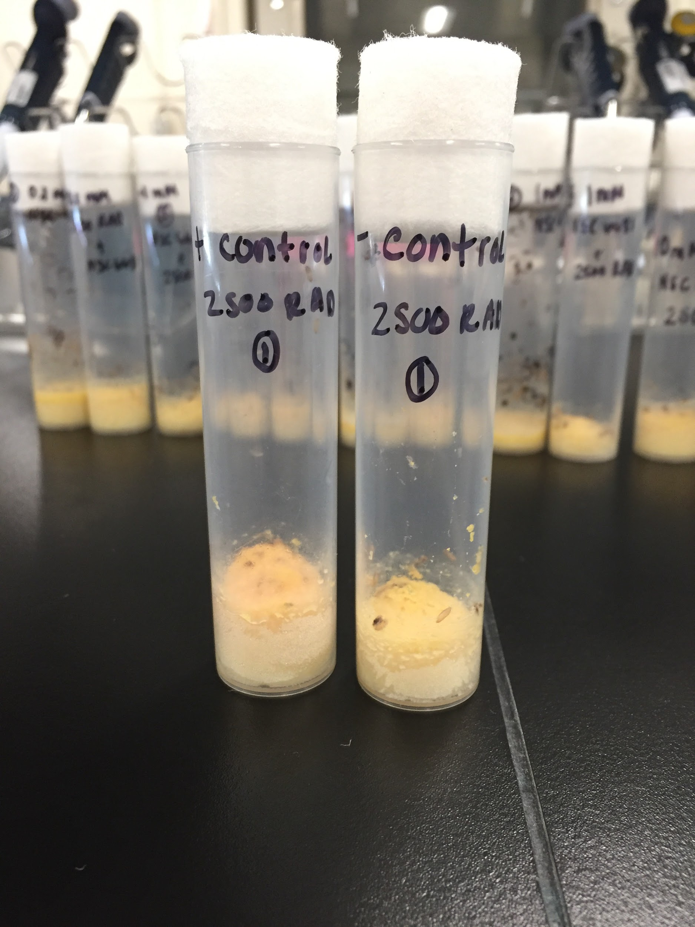
Combination Therapy: NSC 66811 and Radiation as a Cure for Cancer
Krystal Ellison, Francesca Ortega, Jaime George & Joanna Casillas
Department of Molecular, Cellular, and Developmental Biology
University of Colorado-Boulder
Abstract
Introduction
Methods
Conclusions
As cancer becomes the second leading cause of death in the U.S. [2], finding treatment that is both specific and targeted has become a priority for patients and researchers worldwide [2]. Various cancers disrupt biological behaviors and create issues within the body that are all extremely hard to treat. Current treatments create more issues with patients, inducing several side effects. A majority of these cancers require a combination of treatments, such as combining radiation and chemotherapy.
Initially, it was decided to test peptide PNC-27 because it targets a specific protein within cancer cells. After further research, it was concluded that the FDA declared PNC-27 as not viable for human trials due to its toxicity and additional controversy surrounding the company manufacturing the peptide [1].
In order to study the effect of NSC 6681, the end result data of dead and alive drosophila, administered three different dosages compared to a correct negative and positive control groups, was observed and calculated. Due to the ability NSC 6681 has to be toxic in extreme doses, if the dosage of the agonist is increased, then the amount of dead drosophila will have an increase or decrease that is consistently different than the control groups. Results from this study are shown to be ….
Researching the effects of different drugs on invertebrates opens the door for understanding how to move on to mammalian animals are affected by possible chemotherapies. Knowing the effects of drugs such as PNC-27 and NSC 668 create a conversation about how non-pharmaceutical affects cancer, and if there are any obvious implications of toxicity before moving onto more serious trials. In this research there were technical errors such as the casualties/fatalities of the subjects used and time available to run the experiment in a class setting.
With 598,038 annual deaths in the United States in 2016, cancer is one of the leading causes of death worldwide and finding the cure has become increasingly important [2]. While there are several effective treatments for cancer, no single drug or therapy has completely eradicated cancer. The challenge with finding a cure for cancer stems from the fact there are many different types of cancer and different mechanisms that cause cancer. One treatment strategy that is effective has been combination therapy. By combining combinations of surgery, radiation, and chemotherapy, cancer may be effectively combated. The figure below shows the relationship between chemotherapy, radiation, and the probability that the patient would survive.
One potential chemotherapy drug is the compound PNC-27. PNC-27 is a peptide that targets cancer cells by binding to HDM2/MDM2 proteins [3]. HDM2/MDM2 occurs in cancer cell membranes at very high levels. PNC-27 works by inhibiting the E3 ubiquitin ligase that is involved in apoptosis; specifically, PNC-27 inhibits HDM2/MDM2 [4]. Moreover, PNC-27 is especially exciting as it has its own built-in delivery mechanism, can act independently, and induces membranolysis [5]. Despite all of the excitement for PNC-27, it has been surrounded by controversy. The FDA has strongly urged that no humans take this drug after bacteria was found in several solutions that were on the market [1].
One drug that could be a ideal alternative to PNC-27 is NSC 66811 (National Service Center), a compound engineered by the National Cancer Institute. NSC 66811 is another E3 ubiquitin ligase inhibitor [5] that acts as an MDM2 antagonist to disrupts the MDM2-p53 interaction which induces p53-dependent apoptosis [6]. Furthermore, NSC 66811 has already been tested in head and neck cancers, which verifies that it is not too toxic for human use. Along with PNC-27, this drug also has a mechanism targeted for cancer that is unique.
To test this, Drosophila Melanogaster were used. Drosophila Melanogaster was a sufficient model for testing possible cancer treatments because the fly’s development acts similar to tumor development. Drosophila’s short and fast life cycle was convenient as researches can quickly screen various drugs in a short amount of time. Drosophila were a great genetic model because of their ability to generate and maintain mutations. One such mutation, the grapes mutation, was used to test the impact of radiation. This mutation impacts a checkpoint protein that regulates the cell’s response to DNA damage. Mutating the protein, makes it difficult for DNA to repair itself and prevents larvae from becoming sensitive to radiation.
To test the effectiveness of NSC 66811, Drosophila were “treated” in the third instar larvae stage, as this is when Drosophila’s cells are dividing the most rapidly. The Drosophila were treated in combination with radiation to can show the effectiveness of combinatorial therapy.
Subjects:
Drosophila Melanogaster were maintained at the University of Colorado Boulder for two weeks from embryo to adult development. The third instar larvae were irradiated and received varying amounts of NSC 66811. The third instar larvae were stored at room temperature, 77° F, in a 12 hour light/dark cycle
Compound Administration:
The trials were completed as a 1:10 serial dilution. The 500uL stock solution of NSC 66811 (Bristol, UK) had a of concentration of 10mM. The three concentrations tested were 0.1mM, 1.0mM, and 10mM. The 0.1mM and 1.0mM were diluted with 450uL of deionized water.
The larvae were placed into vials containing 5mL of Nutri-fly food (El Cajon, CA) and 5uL of the respective concentrations. Each concentration had three sets of equivalent vials. At each concentration, the vials contained either: NSC 66811 without 2500 rad or NSC 66811 with 2500 rad.
Two vials were used for the positive control (colchicine): one that received 2500 rad and one that did not receive radiation
Two vials were used for the negative control (deionized water): one that received 2500 rad and that did not receive radiation.
20uL of deionized water was added to the vials to add moisture to the compounded food.
The larvae were labeled with a mark indicating negative GFP.
Lastly, the flies were marked dead or alive.
We did not find any “hits” which meant that none of the pupae were greater or less than two standard deviations from the mean, indicating significant resutls.
The hypothesis showed as the concentration of the compound increases, there will be an increase in drosophila death. In addition, is was predicted that the controls would prove with this hypothesis that a optimal dose can be found through the dosage series. After thorough examination of the results, it is concluded that although our lowest dose of 0.1mM has the lowest percent of survival, our 10mM concentration produced a percent survival that was in between our positive and negative controls. Our 1mM concentration produced the highest percent survival rate, therefore a normal dosage should show a survival rate in between 10% and 50% but it did not. With consideration of combination therapy, radiation was predicted to kill 50% of the population, which is closely shown in 1mM concentration of NSC 66811. With combination therapy of radiation and dose, our 1mM concentration produced best results of apx. 33% survival rate. With these findings it is evident that combination therapy is more effective than simply the drug alone.
Future Directions
Testing different approaches of chemotherapy in use with radiation allows researchers to take more in depth look into how certain non-pharmaceutical drugs are differently selective in their biological process. Taking a non-traditional approach to chemotherapies that target all healthy cells makes the search for a better chemotherapy focused on drugs that are aimed towards eliminating specific proteins that have high levels in cancer cells. Besides not getting peptide PNC-27 in time begin the study, our work with NSC 6681 was majorly limited by the lack of time to run through different sets of trials and solutions. The next project forwards should include testing from different stock solutions and concentrations in more than one multiple trial. The research presented was done in a regulated lab at the University of Colorado Boulder, ensuring approved ethics standards by institutional board.
Results
Graph 1 presents the average percent survival of gfp negative flies for 0.1 mM, 1 mM, and 10.mM of NSC 66811 and for the positive and negative controls.
Acknowledgments
Hypothesis
A notable recognition to Tin Tin Su, the Principle Investigator and sponsor of research.
A special thanks is the Howard Hughes Medical Institute, Department of Molecular, Cellular, and Developmental Biology, Biological Sciences Initiative for providing the funding sources for the research done in the Drug Discovery Lab.
We would like to extend our sincere gratitude towards Dr. Pamela Harvey and Dr. Maureen Bjerke for their guidance and experience. We would like to thank our TAs for their time and support throughout the study.
An increase in the concentration of the compound NSC66811 will cause a significant amount of targeted drosophila flies killed with a combination of radiation therapy.
During the experiment, one of the vials that had 0.1mM NSC 66811 was lost. Moreover, no flies with the mutation were found in the vial for colchicine and radiation or in the vial for DI water and radiation.
References
Center for Drug Evaluation and Research. (n.d.). Drug Safety and Availability - FDA warns cancer patients not to use PNC-27 products for treatment. Retrieved from https://www.fda.gov/Drugs/DrugSafety/ucm536094.htm
Centers for Disease Control and Prevention. (n.d.). FastStats - Leading Causes of Death. Retrieved from https://www.cdc.gov/nchs/fastats/leading-causes-of-death.htm
Ehsan Sarafraz-Yazdi, Wilbur B. Bowne, Victor Adler, Kelley A. Sookraj, Vernon Wu, Vadim Shteyler, Hunaiz Patel, William Oxbury, Paul Brandt-Rauf, Michael E. Zenilman, Josef Michl, Matthew R. Pincus. (2010). Anticancer peptide PNC-27 adopts an HDM-2-binding conformation and kills cancer cells by binding to HDM-2 in their membranes. Proceedings of the National Academy of Sciences. 107 (5) 1918-1923; DOI:10.1073/pnas.0909364107
The Truth About Chemotherapy - Toxic Poison or Cancer Cure? (2017, August 25). Retrieved from https://thetruthaboutcancer.com/truth-about-chemotherapy/
Tocris. (n.d.). Ubiquitin E3 Ligases. Retrieved from https://www.tocris.com/pharmacology/ubiquitin-e3-ligases
Sookraj, K.A., Bowne, W.B., Adler, V. Sarafraz-Yazdi, E. Michl, J. Pincus M.R. (2010). The anti-cancer peptide, PNC-27, induces tumor cell lysis as the intact peptide. Cancer Chemother Pharmacol. 66: 325. https://doi.org/10.1007/s00280-009-1166-7

